Slide 1
CANCER TREATMENT COSTS
Esti Stern

Slide 2
Agenda
Business Problem
Data Overview
Exploratory Data Analysis
Methodology
Models
Final Model
Conclusion
Next Steps

Slide 3
Business Problem
The soaring costs of cancer treatment often place an overwhelming financial strain on patients and families.
A key factor in managing treatment costs is how insurance companies assess and allocate coverage.
By predicting treatment costs, insurers can set premiums that balance affordability for the customers with sustainability for the company.
With a clearer picture of potential costs, insurers could offer personalized recommendations and better financial support for patients, improving the customer experience.

Slide 4
Data Overview
Dataset Dimensions:
Rows: 50,000
Columns: 15 (original including target variable)
Time Span:
Years Covered: 2015 – 2024
Data Quality:
No null values
No duplicate records
Target Variable:
Treatment Cost (USD)
Feature Engineering:
One-hot encoding expanded features to 29
18 columns discarded (from encoded Cancer Type and Country)
Final Model Input: 11 selected features

Slide 5
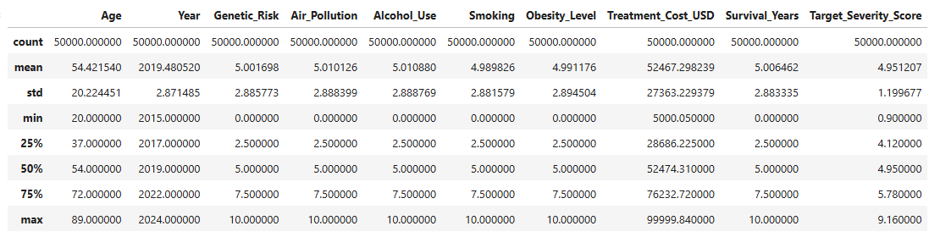
Exploratory Data Analysis – Descriptive Statistics
Age: Mean = 54.4, Range = 20 – 89
Genetic Risk, Air Pollution, Alcohol Use, Smoking, Obesity Level: All scaled 0 – 10 with similar distributions (mean ≈ 5.0)
Treatment Cost (USD): Mean = $52,467, Range = $5,000 - $99,999, Std Dev = $27,363
Survival Years: Mean = 5.0, Range = 0 – 10
Severity Score: Mean = 4.95, Range = 0.9 – 9.16
Most features are symmetrically distributed around their midpoints

Slide 6
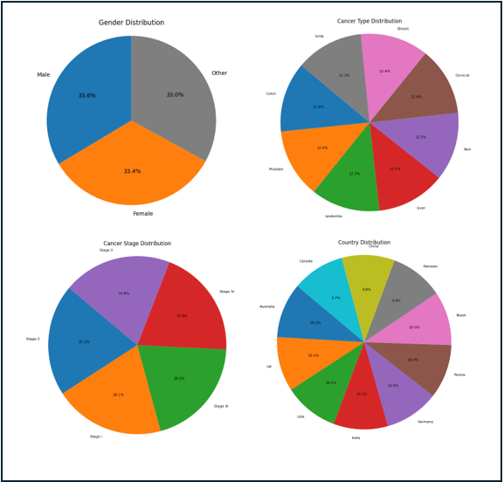
Exploratory Data Analysis – Feature Distributions
Gender
Cancer Type
Cancer Stage
Country
All groups are evenly represented

Slide 7
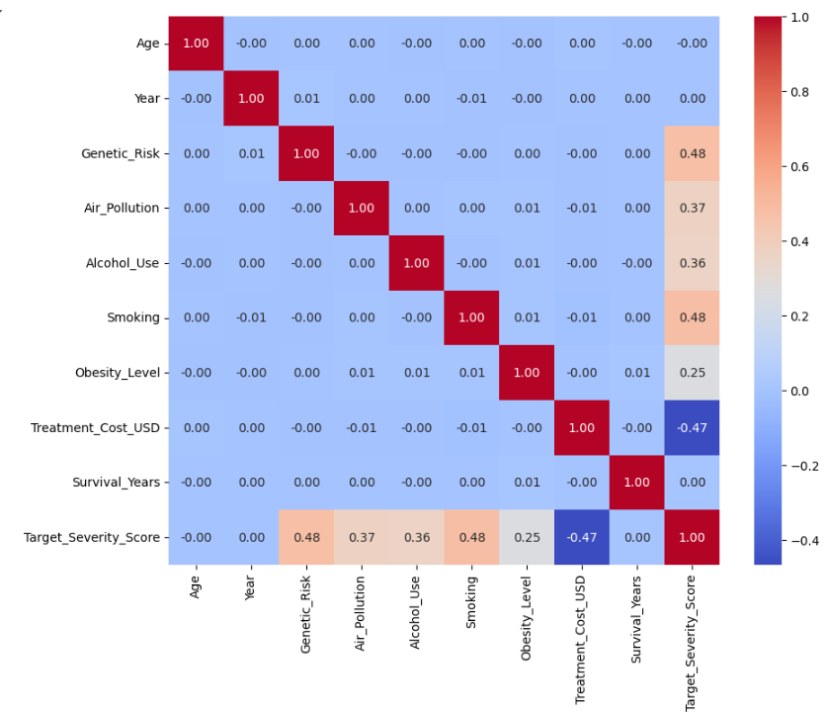
Exploratory Data Analysis – Correlation Heatmap
Only Severity Score has a significant linear correlation with Treatment Cost
Genetic Risk, Air Pollution, Alcohol Use, Smoking, and Obesity Level all have some linear correlation with Severity Score

Slide 8
Methodology
Step 1: Data Exploration
Analyzed feature distributions & correlations
Encoded categorical variables (One-hot & Ordinal)
Step 2: Modeling & Comparison
Trained Random Forest & XGBoost
Used LazyPredict to explore alternatives, chose Bayesian Ridge
Step 3: Evaluation & Tuning
GridSearchCV (3-fold) for hyperparameter optimization
Metrics: RMSE & R²

Slide 9
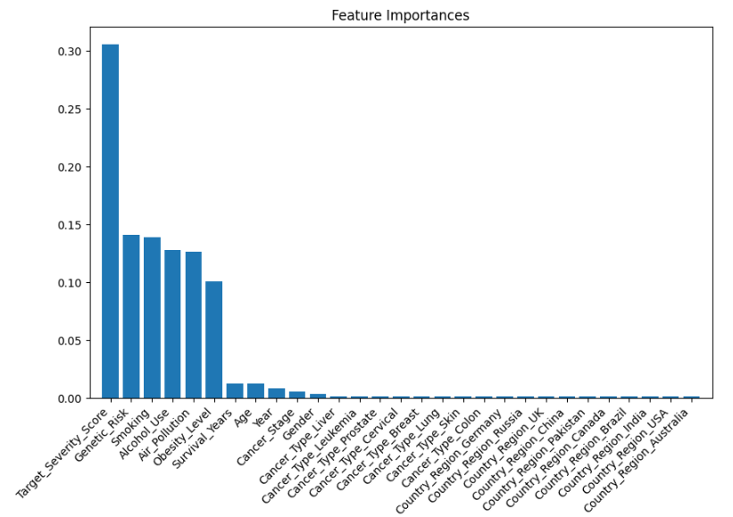
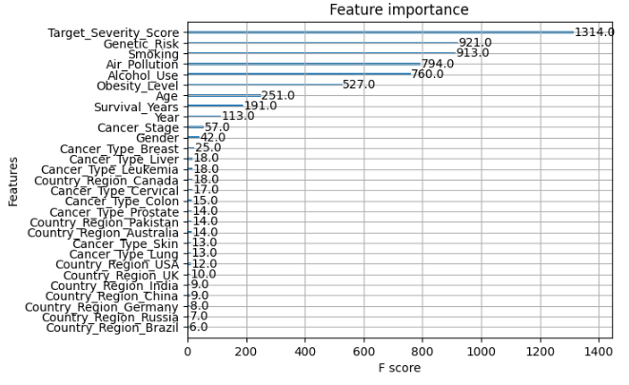
Models – Feature Selection
Random Forest
XGBoost

Slide 10
Final Model
Final Model: Optimized XGBoost Regressor
Achieved RMSE of 3,156 & R² of 0.9867
Selected based on balance of accuracy and generalization

Slide 11
Conclusion
Although performance of the XGBoost model slightly improved with all features, selected features were removed to simplify the model and reduce overfitting.
Genetic and environmental factors – though indirect – emerged as key drivers of disease severity and treatment costs.
Insurance providers can leverage this model to design more personalized policies based on patients’ individual risk profiles and anticipated treatment costs.
Healthcare practitioners can use the model to promote transparency, helping patients better understand potential expenses and make more informed decisions.

Slide 12
Next Steps
Future improvements include adding treatment type, therapy duration, length of hospital stay, insurance coverage
These factors may enhance predictive accuracy
Could deepen insights into cost drivers and care pathways

Slide 13
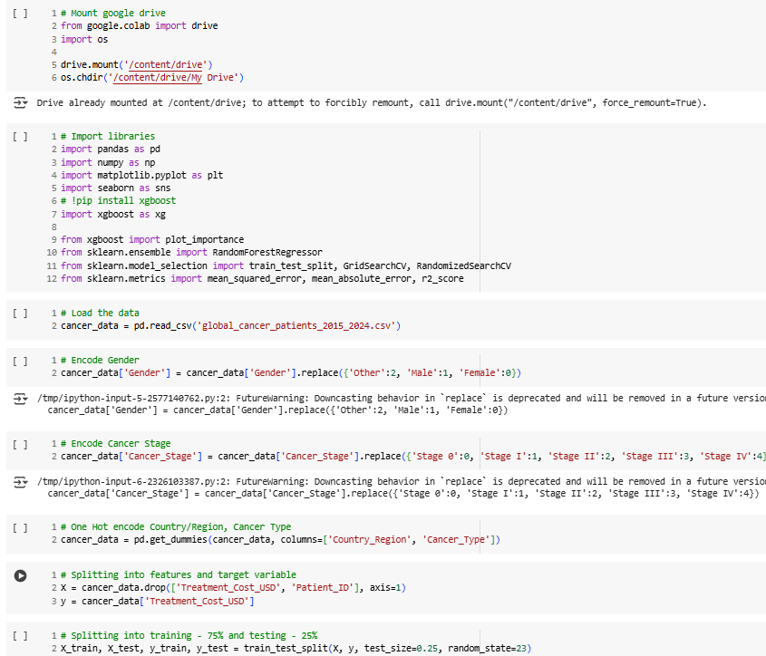
Appendix

Slide 14
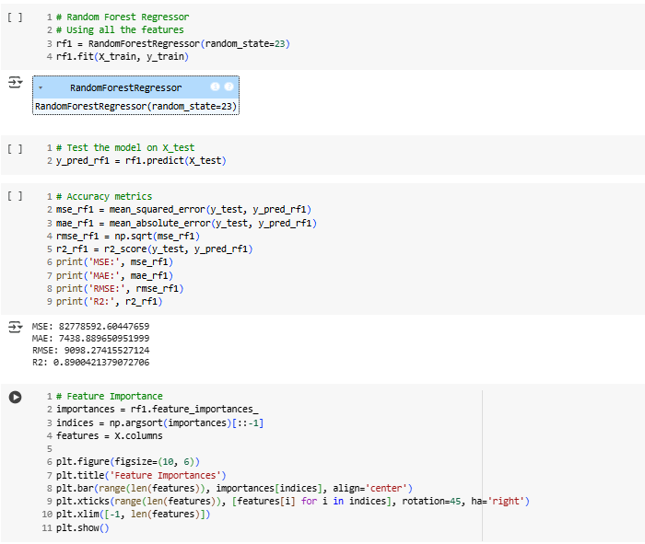
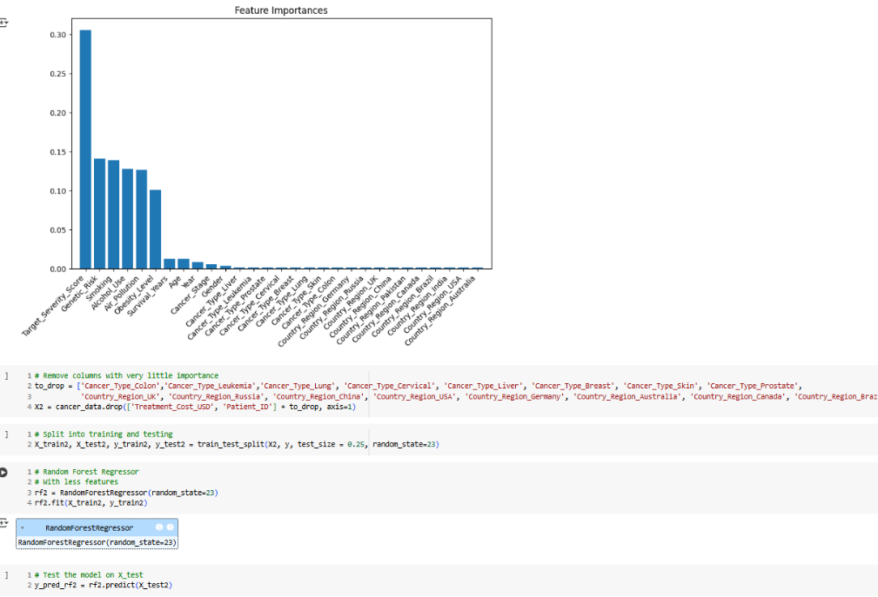

Slide 15
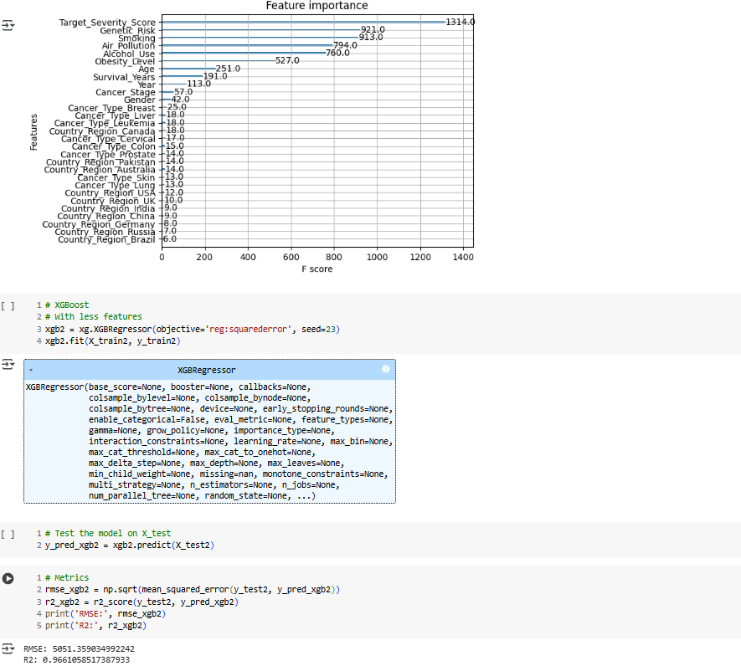
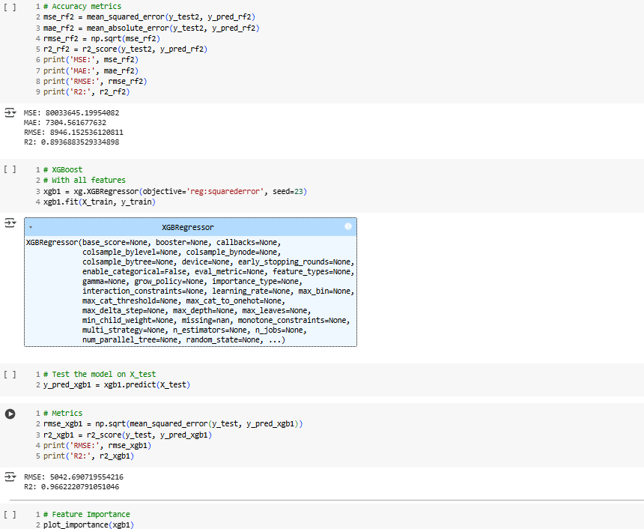

Slide 16
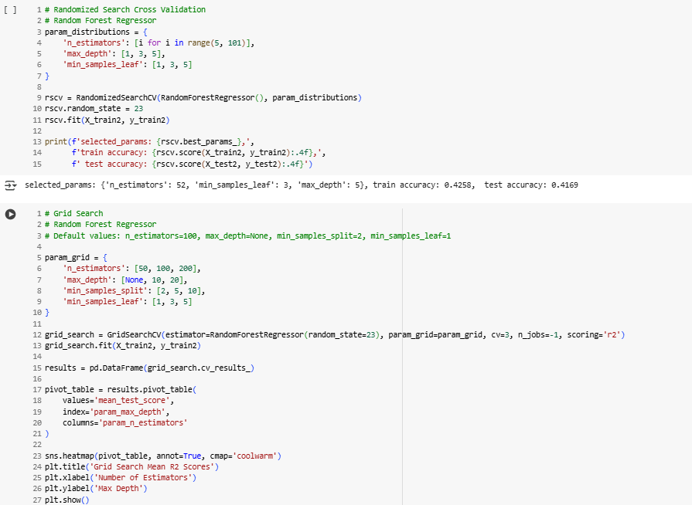
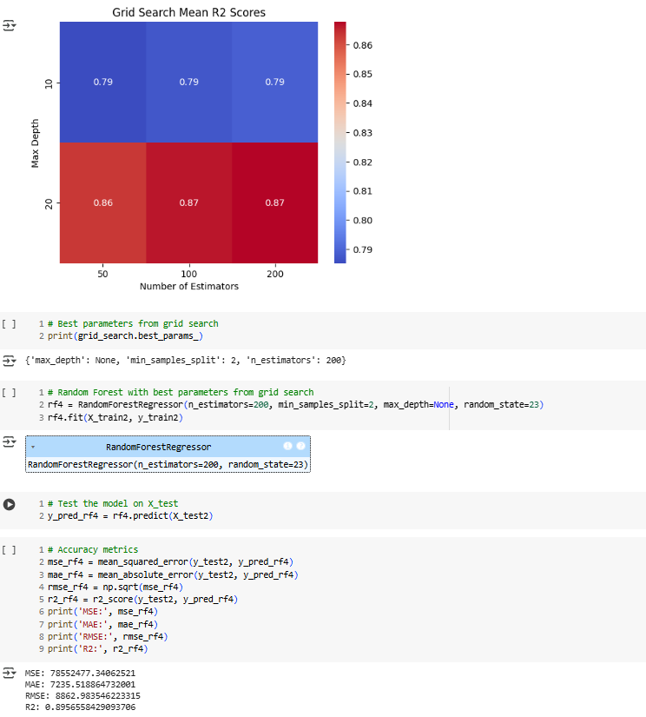

Slide 17
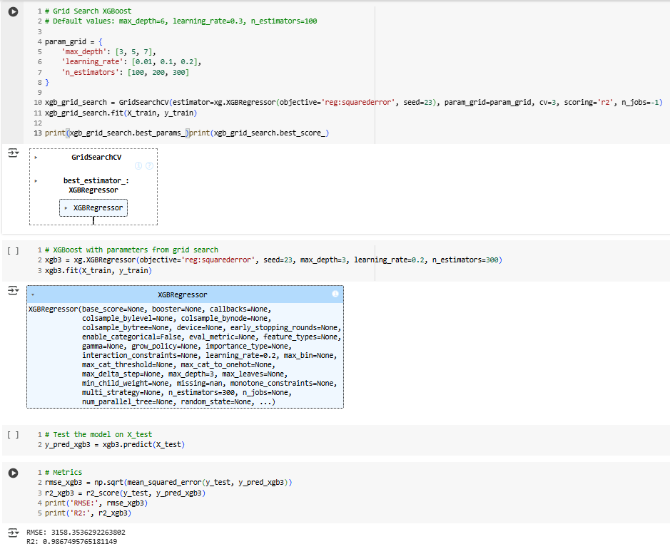

Slide 18
